Slide 1
RADAR: Risk Assessment for Database Attack Resistance
CSCI 699: Advanced Computer Security
Ashok Deb (adeb@usc.edu)
ASM Rizvi (asmrizvi@usc.edu)
Rajat Tandon (rajattan@usc.edu)
6 December, 2017

Slide 2









Bottom Line Up Front
Data – Analysis – Conclusion – Recommendation
PREVENT-reduce the probability an attack happens
R1: Two Factor Authentication
R2: Security Education
DETER-reduce the probability an attack happens to you
R3: Encrypt Portable Devices
R4: Software Updates
R5: Robust Email Handling
MITIGATE-increase the probability that you can survive an attack
R6: Backup Data
R7: Cybersecurity Insurance
Defense in Depth

Slide 3
Agenda
Background / Motivation
Data
Prevention Recommendations
Deterrence Recommendations
Mitigation Recommendations
Related Work
Future Work
Conclusion
Questions
Notes:
Douglas Shook was appointed chief information officer on January 1, 2016.
His portfolio includes the university’s wired and wireless networks, telecommunications, information security, business applications, educational technologies, Web Services, data center, and the Center for High-Performance Computing (HPC).
He holds a B.A. in English Literature and Journalism from the University of Michigan and a Ph.D. in Communication Research and Theory from the Annenberg School for Communication and Journalism.

Slide 4
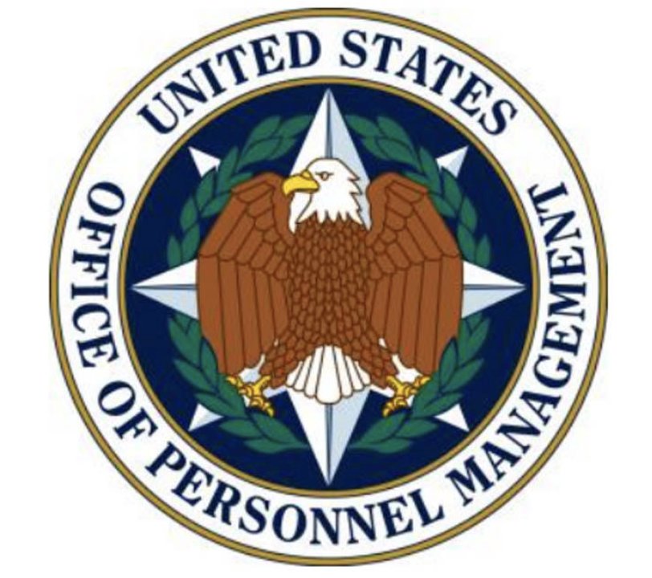




Background / Motivation
CIA operatives could be recovered from OPM hack²
US Military Joint Staff email down for 11 days¹
Bangladesh Bank Breach³
$101M withdrawn by hackers
$81M transferred to Philippines
$20M transferred to Sri Lanka
$38M recovered
Governor resigned
¹ http://www.dailymail.co.uk/news/article-3187344/Russia-hacked-Joint-Chiefs-Staff-shut-email-4-000-defence-department-employees-ELEVEN-DAYS.html
² https://hacked.com/cia-pulled-spies-beijing-opm-breach/
³ https://www.wired.com/2016/05/insane-81m-bangladesh-bank-heist-heres-know/
Notes:
Bangladesh bank attack
Loss of credit card – financial damage
OPM-–national security
10838 records

Slide 5
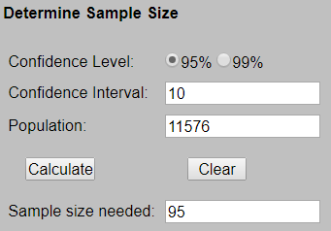
Data
Main Issue with Data
11,576 breaches
Privacy Rights
100 Randomly selected breaches with 25% weightage to each set
No central repository where all breaches can be found
Incomplete information about the breaches on web
Vigilante.pw
Information is Beautiful
Wikipedia
Notes:
Where we got from
Citation at the bottom the side
Summary statistics

Slide 6
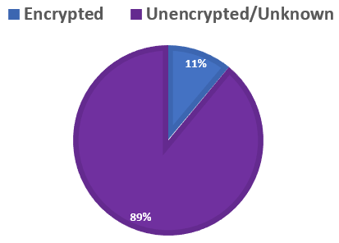
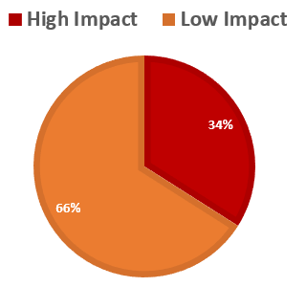
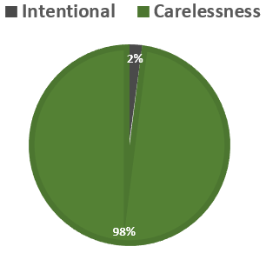
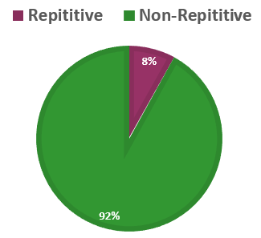
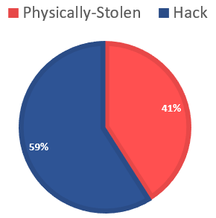
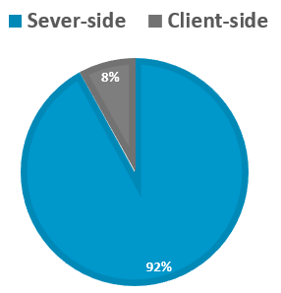
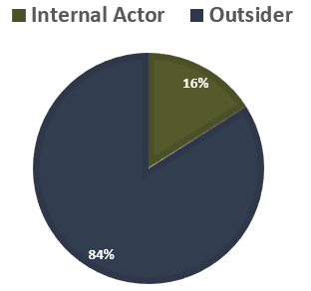
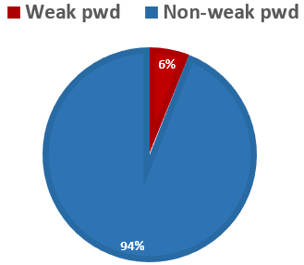
Analysis Results

Slide 7
Analysis Results

Slide 8

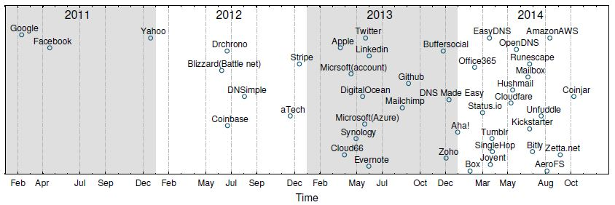
R1: Two Factor Authentication (2FA)
We can handle around 28% data braches using 2FA.
Vulnerabilities with MD5. We found around 4% breached websites used MD5 hashing.
Most popular sites support 2FA now.
61.75% users who use mobile devices to recover gmail account.
However, only 6.39% Google users use 2FA.
Notes:
Thomas, Kurt, et al. "Data Breaches, Phishing, or Malware? Understanding the Risks of Stolen Credentials." (2017).
https://www.theregister.co.uk/2017/11/10/google_password_hijack/
Petsas, Thanasis, et al. "Two-factor authentication: is the world ready?: quantifying 2FA adoption." Proceedings of the eighth european workshop on system security. ACM, 2015.

Slide 9
R2: Security Education
Nearly two-thirds of people use the same password for their many different accounts.
In a separate dataset, 4.55% users use login name as password (292, 658 users from 6, 428, 632 users).
DO NOT click all the links you get.
Train employees. We find 29 such organizations who provide security training.
Educate people about misconceptions.
Notes:
Entrepreneur article by Carly Okyle: https://www.entrepreneur.com/article/242208
Taringa data breach: https://thehackernews.com/2017/09/taringa-data-breach-hacking.html
Shen, Chao, et al. "User practice in password security: An empirical study of real-life passwords in the wild." Computers & Security 61 (2016): 130-141.

Slide 10



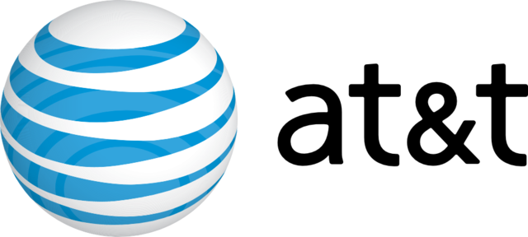
R3: Encrypt Portable Devices
We found a numerous number of breaches from stolen laptop, portable devices, etc.
NASA
In three incidents, NASA lost information about their employees, algorithms, etc. from stolen laptops. Now, they make a rule of not taking unencrypted laptops from NASA facility.
AT&T
A laptop was stolen from a car containing unencrypted Social Security numbers and bonus/salary info of AT&T employees in 2008.
Notes:
Images from Google

Slide 11
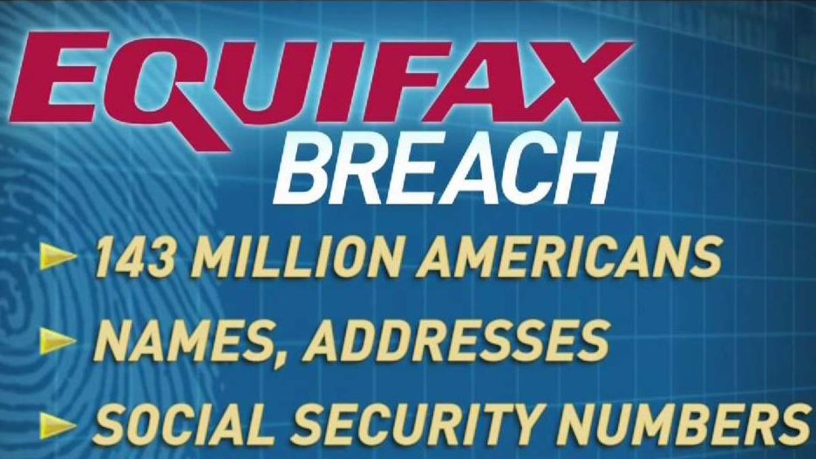
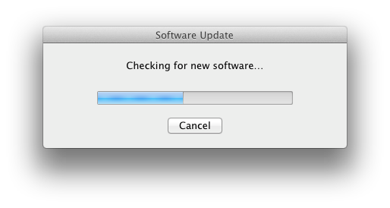
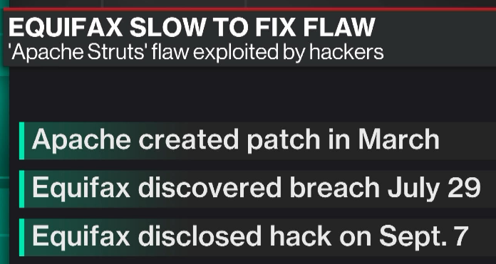
R4: Software Updates
An analyst firm surveys 318 companies and finds that more than 80 percent of discovered breaches occurred due to patches pending for more than 10 days and even up to a year.
The vulnerability that caused the equifax breach was disclosed back in March.
There were clear and simple instructions of how to remedy the situation.
Companies should have procedures in place to follow such advice promptly.
Notes:
https://www.wired.com/story/equifax-breach-no-excuse/

Slide 12
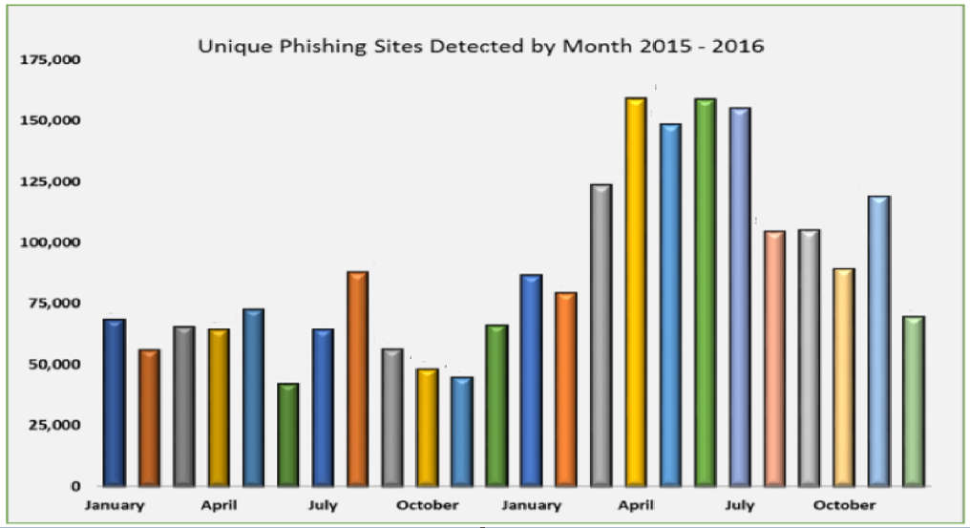
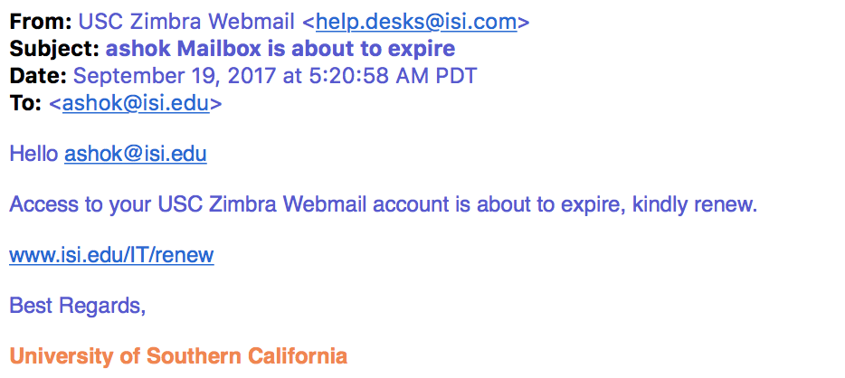
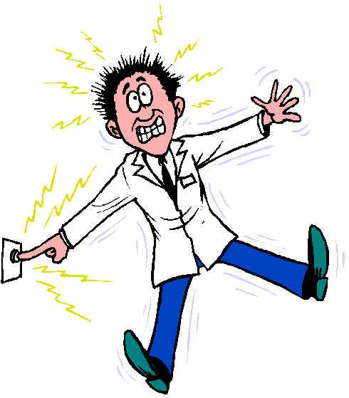
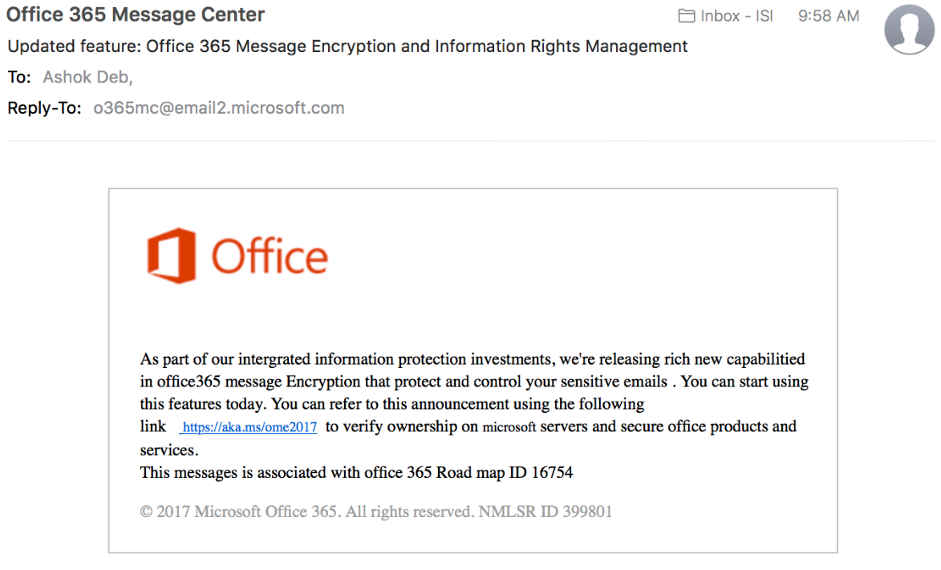

R5: Robust Email Handling
http://rackerhayespreschool.org/wp-content/zim.php
APWG recorded more phishing in 2016 than in any year since it began monitoring in 2004
“One wrong click may give you a flick.”
-Rajat Tandon
Notes:
https://www.csoonline.com/article/2132618/phishing/social-engineering-11-tips-to-stop-spear-phishing.html

Slide 13
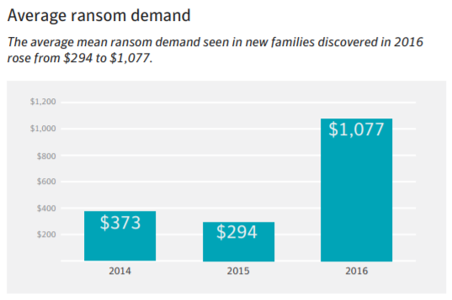
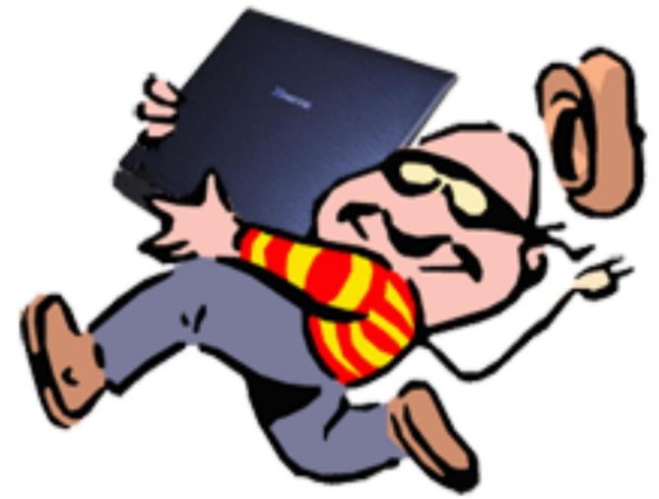
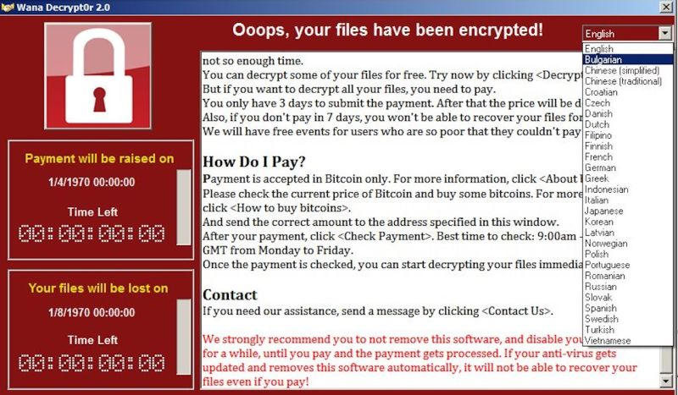
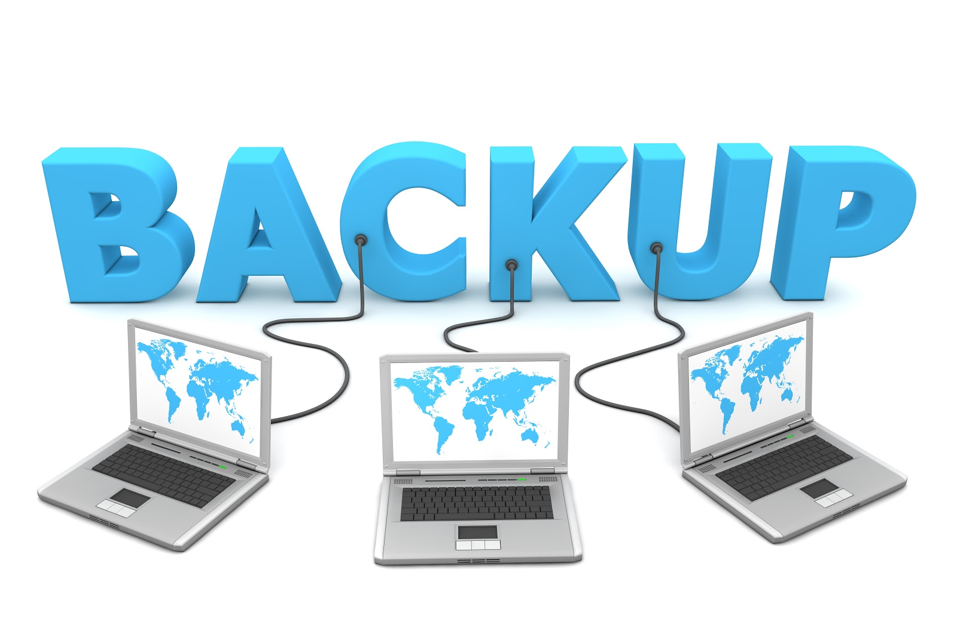
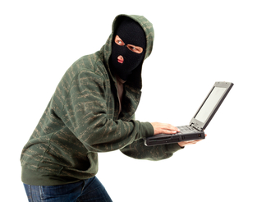

R6: Backup data
Every 10 seconds, a consumer gets hit with ransomware.
A wrong click by a user can lay the best laid (and most expensive) security plans to waste.
Phishing email attachments have become the #1 delivery vehicle for ransomware
Notes:
https://www.csoonline.com/article/3212260/ransomware/the-5-biggest-ransomware-attacks-of-the-last-5-years.html
https://blog.barkly.com/ransomware-statistics-2016
Hosptial payed the money
Ransom ware
Does your company isolate customer information databases and payment/point-of-sale systems from other, less secure systems?

Slide 14
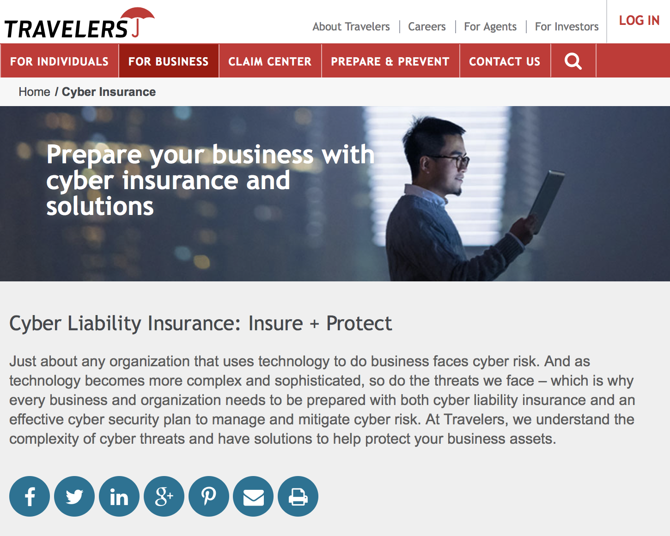
R7: Cybersecurity Insurance
Cybersecurity insurance can mitigate losses from a variety of cyber incidents, including data breaches, business interruption, and network damage.¹
Encourages the implementation of best practices by basing premiums on an insured’s level of self-protection.¹
Encourages a cyber incident data repository to identify emerging cybersecurity best practices.¹
State of the Art not there
²
¹Department of Homeland Security National Protection and Programs Directorate (NPPD) https://www.dhs.gov/cybersecurity-insurance
²Travelers Insurance https://www.travelers.com/cyber-insurance
³Ponemon 2014 Institute Cost of Data Breach Study https://www-935.ibm.com/services/multimedia/SEL03027USEN_Poneman_2014_Cost_of_Data_Breach_Study.pdf ⁴NetDiligence 2013 Cyber Liability & Data Breach Study https://netdiligence.com/wp-content/uploads/2016/05/CyberClaimsStudy-2013.pdf
Notes:
Lost Data
If a breach does occur, a Travelers cyber policy can cover breach notifications and remediation expenses, subject to the applicable retention. It also can cover defense expenses such as responding to and cooperating with regulatory investigators.
Lost Devices
Notification Requirements
Notifying customers of a breach and other post-breach responses, which is mandated by law, can add up, averaging $1.72 million according to one survey of U.S. businesses.* As part of the a cyber policy, Travelers would refer the customer to a law firm to serve as counsel and breach coach and help reimburse those costs, subject to the applicable retention.
Forensics
Computer forensics teams can determine the extent of a breach and whether private customer information may have been compromised. A Travelers cyber policy would reimburse the insured, subject to applicable retention, for computer forensic experts.

Slide 15
Conclusion
Data – Analysis – Conclusion – Recommendation
PREVENT-reduce the probability an attack happens
R1: Two Factor Authentication
R2: Security Education
DETER-reduce the probability an attack happens to you
R3: Encrypt Portable Devices
R4: Software Updates
R5: Robust Email Handling
MITIGATE-increase the probability that you can survive an attack
R6: Backup Data
R7: Cybersecurity Insurance
Defense in Depth

Slide 16
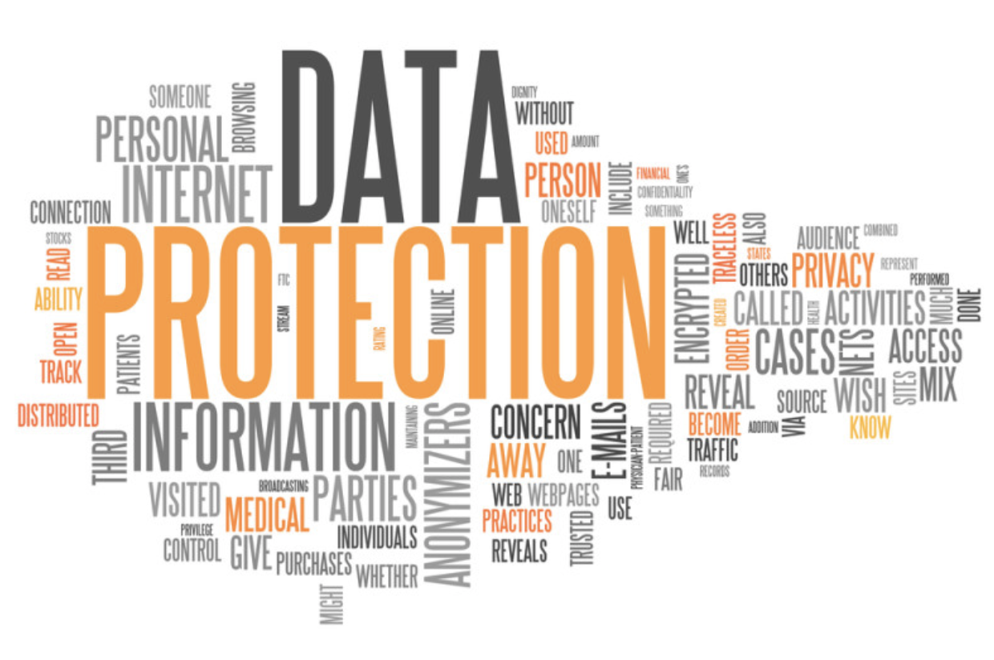
Questions
Our data, draft paper and slides are available at:
https://github.com/A-Deb/Data_Breaches

